Slide 1
Ai Tomato Leaf Disease Detector
By Maximus Castro

Slide 2
How it works?
This project showcases an AI system that can detect the condition of tomato leaves based on images and pictures. The AI can identify whether a tomato leaf is healthy or affected by a specific type of disease.

Slide 3
What does it run on?
The Ai is running on resnet or image net. Basically what that means is that it identify only on images and pictures taken and identify it there. The Ai will be modify to do detection net as well which can run on an external camera live, but for right now, it runs on resnet.

Slide 4
Goal of this product
The goal for this Ai product is to help farmers fix their issue with tomatoes. Sometimes it's hard to identify whether a tomato plant is healthy or is affected by something. With this Ai product, farmers can apply the appropriate treatment based on the leaf condition and overall improve plants health.

Slide 5
What does the Ai identify?
The Ai can identify many things based on the tomato leaf conditions. It can identify whether its healthy, or encountering Bacterial Spot, Early Blight, Late Blight, Leaf Mold, Mosaic Virus, Septoria Leaf Spot, Spider Mites, or Yellow Leaf Curl Virus.

Slide 6
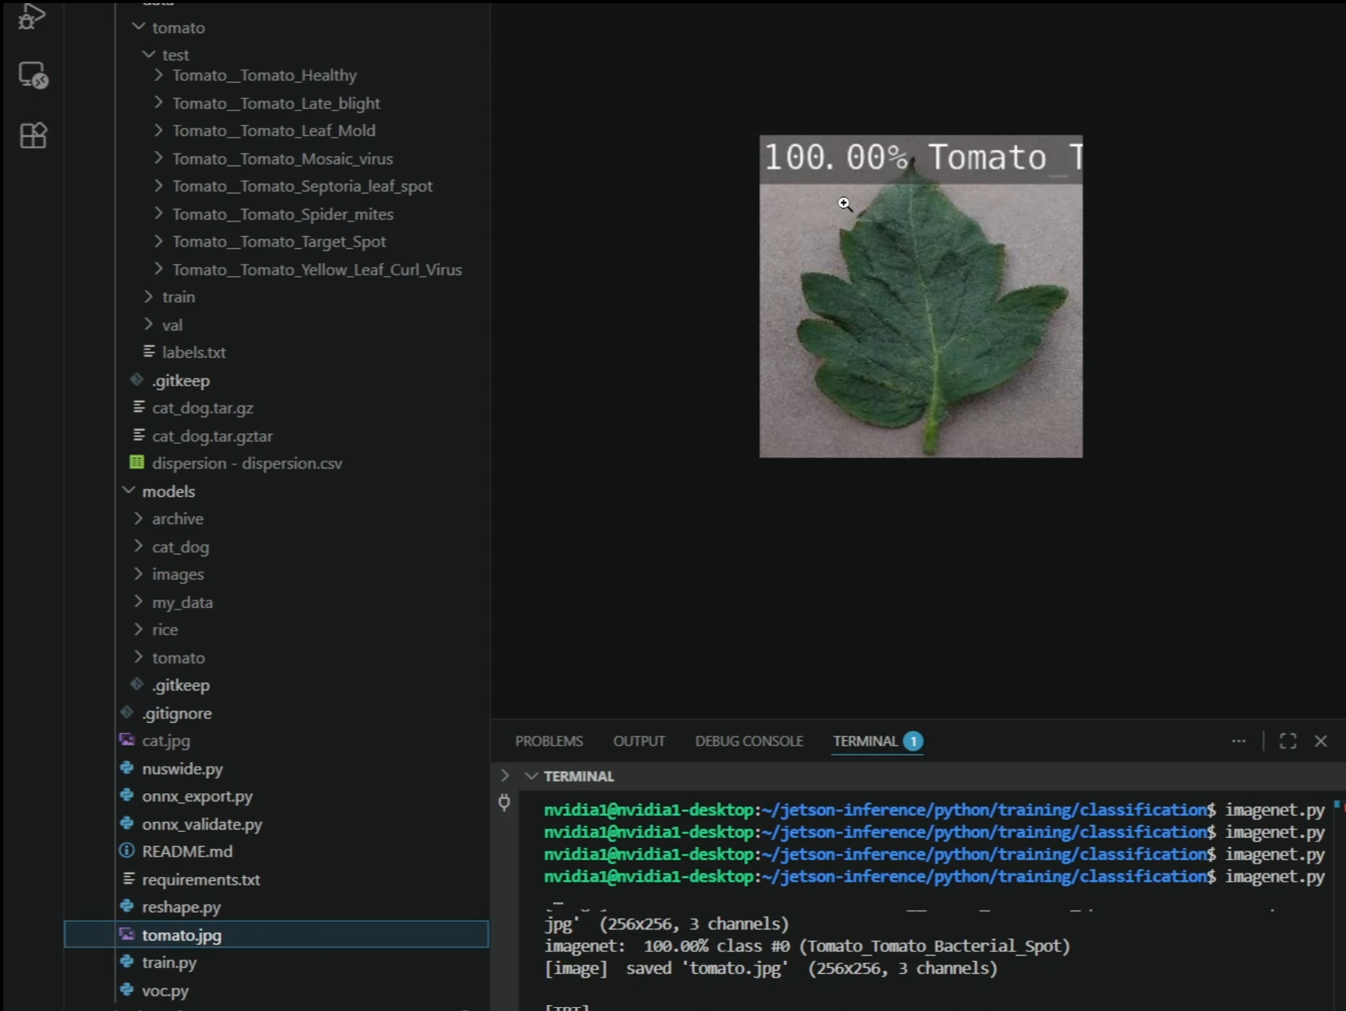
Tests
Here for our prototype we tested our ai to identify the leaf condition of this tomato plant At first, in our human eyes, we think that the leaf here is healthy and have no issue. In the Ai point of view, it identify that this leaf is affected by a bacterial spot which is absolutely right. This ai detects something out of ordinary of what we thought it could be. This prototype can save many tomato plants being affected by these disease.

Slide 7
Future development
As for this product still in its early stages, the Ai might make some errors along the way. I am planning to improve this product by providing better dataset for the Ai to learn and identify unusual patterns that us humans can not see. The Ai is also running on image net which might not be the best for analyzing especially if you want to analyze a huge tomato farm. I should probably make the ai run on detect net, so that way it can analyze results in real time by using a camera. That would be 10x better than taking a picture and analyzing it one by one.

Slide 8
Impact of our product
With the special use of this product, this product can change how tomato farms work. Farmers can now know if their crops is being affected by disease and can apply appropriate treatment for it quickly. With this Ai product, tomato crop growth would increase as well as mitigating the risk of developing bad tomatoes. Food supply and sales for tomatoes would rise exceedingly high with this product. This product can also inspired other product to be developed for other crops as well.

Slide 9
Thank you for Reading my Presentatoin.

